Slide 1
DevOps and Frontend Open Source for Enterprise
Grommet V2 and OSB API
Pramod Sareddy
Fullstack Developer
OSCON 2019
July 17th 2019

Slide 2
Agenda
Grommet
Components
Storybook & Code sandbox
Who’s using Grommet?
Open Service Broker API
Registering a Service Broker
Provisioning and Binding a Service
Kube Service-Catalog Architecture
Kube Service-Catalog Resources
Grommet Broker
Grommet application as a service
Register Grommet Broker in K8 Service Catalog
Demo
References
Notes:
Today we’ll be discussing the HPE Open Source UI component Grommet, it’s components, storybook and who is using it. Also we will be discussing Open Service Broker API, where it comes from, and why it’s useful, and implementation of the OSB API. Then we’ll briefly cover Kube’s service catalog and it’s resources, and then cover the abstractions that Service-Catalog uses to implement the OSB model in Kubernetes. After that We’ll see what Grommet OSB broker offers? And it’s demo. Lastly, we have some time for questions.

Slide 3
What is Grommet?
A UI/UX design system made for React.
Notes:
Ask audience if they’ve heard of Grommet. Other UI kits, twitter bootstrap?
grommet is a react based framework that provides accessibility, modularity, responsiveness, and theming in a tidy package. You can download this package from NPM into your react project and get started.
Grommet website: https://v2.grommet.io/

Slide 4
Inclusive Design
Automatic a11y support
Accessible elements with keyboard navigation
Skip Links – straight forward tab key navigation using Skip Links Anchor
Mobile first approach
Seamless design across all screen sizes
Notes:
Inclusive Design: The design of mainstream products and/or services that are accessible to, and usable by, as many people as reasonably possible ... without the need for special adaptation or specialized design.
In short, A11Y means “accessibility”. A11Y is what is known as a numeronym, which is somewhat similar to an acronym. Unlike an acronym, numbers are used in place of letters to shorten the term. You may already be familiar with other numeronyms, such as “K-9” for “Canine” or “W3C” for “World Wide Web Consortium”.
Keyboard Navigation: You can navigate throughout the web page by using keyboard keys.
Skip Links: Skip links are internal page links which aid navigation around the current page, rather than to completely new pages. https://v2.grommet.io/skiplinks
Mobile First approach: Mobile first”, as the name suggests, means that we start the product design from the mobile end which has more restrictions, then expand its features to create a tablet or desktop version.

Slide 5
Styled Components
Tight coupling between component and styling
Only style the elements you want
Easily apply custom themes to your apps
Avoid CSS class naming collision
Notes:
Tight Coupling: If changing one element requires changing another element then we say there is tight coupling
Style the elements You can only style the elements you want.
Custom themes: Apart from the available theme you can build and apply custom themes. I will show you the custom theme generation in next slide.
CSS naming collision: it automatically generates a unique class name for you which avoids the naming collision.

Slide 6
Theming
Match your company’s branding easily
Custom themes defined in a JSON object
Community built custom theme generators https://grommet-theme-builder.netlify.com/
Easily version control theme using npm
Notes:
Match Company branding easily: Grommet provides different base theme version which can easily match your company branding . Also you can modify slightly to match.
Custom Theme Generator: You can find the community built custom theme generators here where you can make your changes on top of base theme, export and use it for your application.
Easily version Control: Say Xyz company has to 20 application already running, wanted to rebrand them. grommet theme in available npm. So updating npm packages and dependency versions will apply changes to across all the applications.
Rebranding – 20 apps are already running
Updating NPM packages dependency version.

Slide 7
Grommet Components
grommet.io/components
Notes:
Grommet Components: These are the building blocks of the grommet library, master them, and become an expert.
Let’s see a few components now.

Slide 8
Layout
A container that lays out its contents in one direction
A grid system for laying out content
Uses CSS grid browser spec
Powerful app layout native to CSS
Layer is typically modal and anchored to an edge, corner, or center of the window.
Caller's responsibility to provide a control for the user to close the layer.
A container that stacks contents on top of each other
Stack is typically used to decorate Meter, Chart, or icons.
Notes:
Box: A container that lays out its contents in one direction
Grid: A grid system for laying out content
Uses CSS grid browser spec
Powerful app layout native to CSS
Layer: Layer is typically modal and anchored to an edge, corner, or center of the window.
Caller's responsibility to provide a control for the user to close the layer.
Stack: A container that stacks contents on top of each other
Stack is typically used to decorate Meter, Chart, or icons
https://storybook.grommet.io/?path=/story/stack--simple-stack
https://codesandbox.io/s/github/grommet/grommet-sandbox?initialpath=stack&module=%2Fsrc%2FStack.js
https://v2.grommet.io/grid
https://v2.grommet.io/layer
https://v2.grommet.io/stack

Slide 9
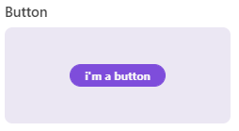
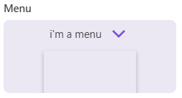
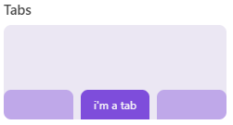
Controls
You can provide a single function child that will be called with 'hover' and 'focus' keys
A text link
Powerful app layout native to CSS
A control that opens a drop containing plain buttons
A container with controls to show one tab at a time
Notes:
Button: You can provide a single function child that will be called with 'hover' and 'focus' keys
Anchor: A text link
Powerful app layout native to CSS
Menu: A control that opens a drop containing plain buttons
Tabs: A container with controls to show one tab at a time
https://v2.grommet.io/button
https://v2.grommet.io/anchor
https://v2.grommet.io/menu
https://v2.grommet.io/tabs

Slide 10
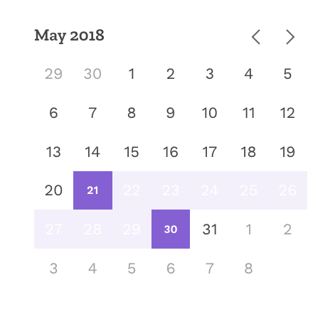
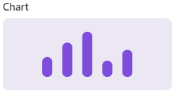
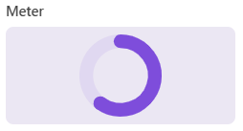
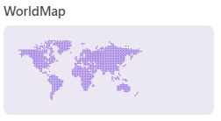
Visualizations
Calendar of days in months
Can be used to select
a single date
a range of dates
multiple individual dates
A graphical chart
Bar, Line, Area
A function to help calculate values for bounds and axis
A graphical meter
Bar, Circle
A map of the world, or a continent
Notes:
Visualizations:Calendar of days in months
Can be used to select
a single date
a range of dates
multiple
Chart: A graphical chart
Meter: A graphical meter
WorldMap: A map of the world, or a continent
Clock, Data table, table, Diagram, Distribution and more ..we have all sorts of other components available but I should only few for taking the time we have in to consideration.
Utilities Skip Links, Announce Context, Collapsible, Grommet, Key board, Responsive text, theme context.
Media video, image, carousel
Input
Colors

Slide 11
Grommet Storybook
storybook.grommet.io

Slide 12
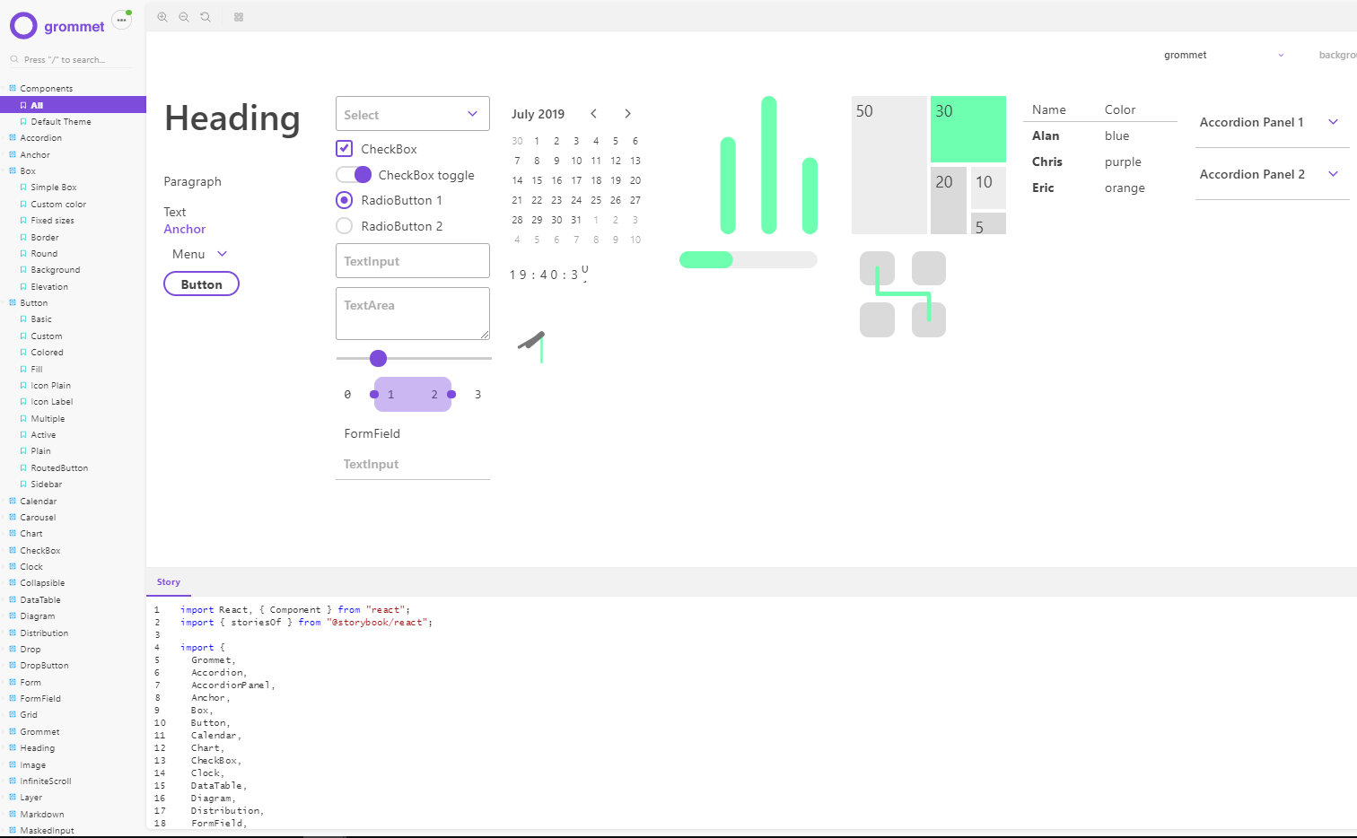
Notes:
https://storybook.grommet.io/

Slide 13
Grommet Code Sandbox
codesandbox.io/u/grommetux/sandboxes
Notes:
https://codesandbox.io/u/grommetux/sandboxes
It’s a grommet code sandbox play ground for each component

Slide 14
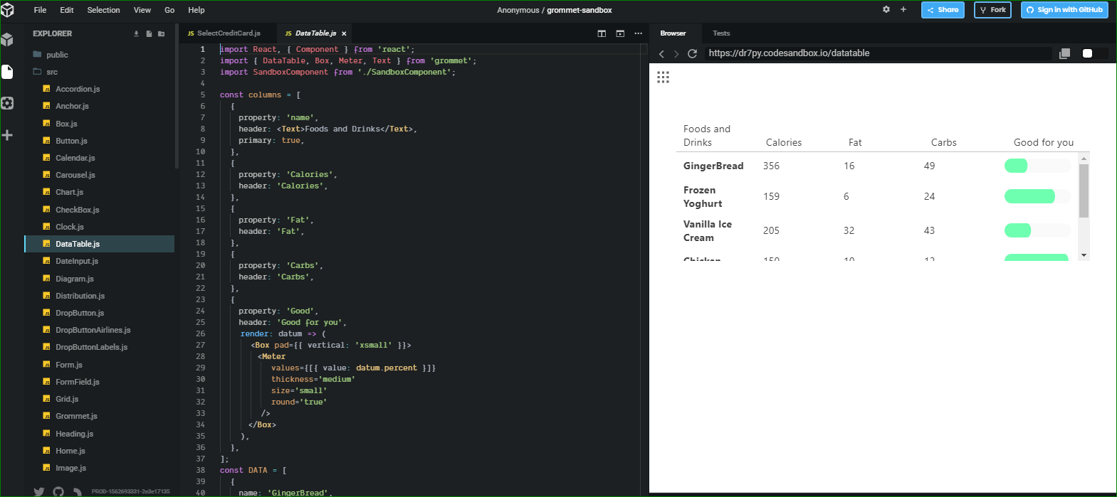
Grommet Code Sandbox
Notes:
https://codesandbox.io/u/grommetux/sandboxes

Slide 15
Who’s using Grommet?

Slide 16
HPEDEV
HPE Developer Community Portal
Notes:
https://developer.hpe.com/

Slide 17
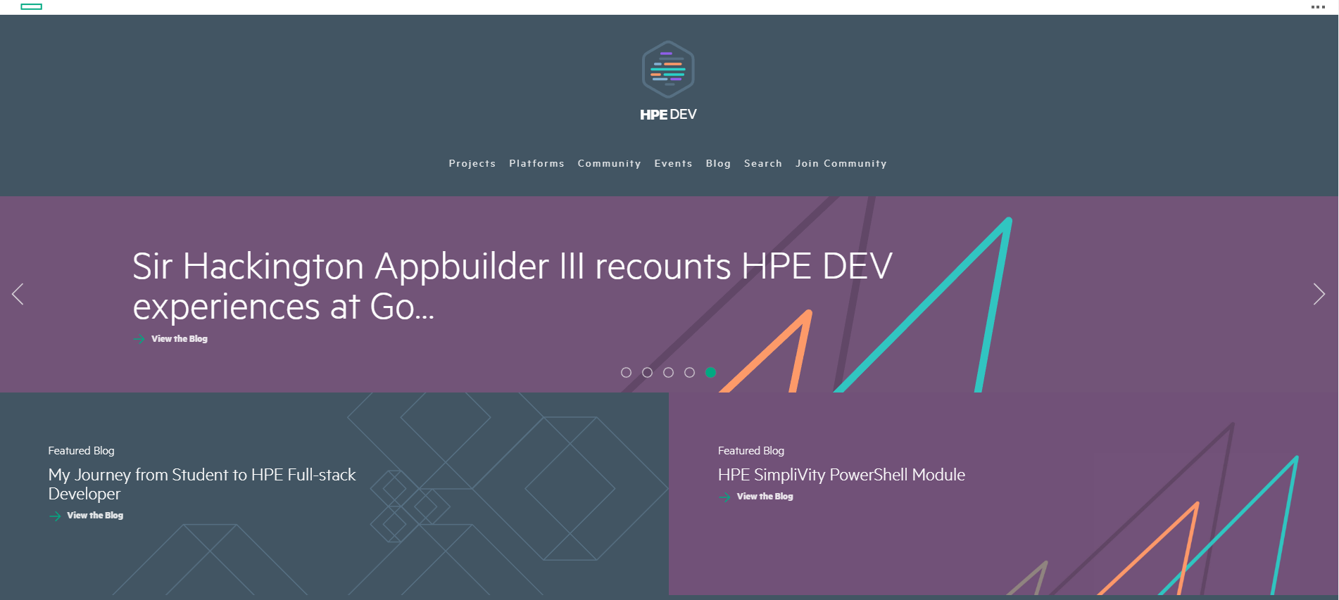
Notes:
https://developer.hpe.com/

Slide 18
Community
Growing since Discover 2015
Vibrant Slack community with over 2,400 members
Grommet organization has 80+ supporting libraries
In 2017 Grommet received 140k downloads
300k downloads in 2018 (Grommet and Grommet icons)
600k downloads in 2019 (Grommet and Grommet icons)
Over 5,500 Github stars
Commits from over 165 individual contributors
Notes:
Growing since Discover 2015
Vibrant Slack community with over 2,400 members
Grommet organization has 80+ supporting libraries
In 2017 Grommet received 140k downloads
300k downloads in 2018 (Grommet and Grommet icons)
600k downloads in 2019 (Grommet and Grommet icons)
Over 5,500 Github stars
Commits from over 165 individual contributors

Slide 19
What’s next?
Read the docs
grommet.io
Visit our Github
github.com/grommet
Join our Slack
slackin.grommet.io
Notes:
Grommet.io
Github.com/grommet
Slackin.grommet.io

Slide 20
Questions?
Notes:
Ok, now that I’ve covered the basics of what Grommet is? It’s components and who is using it. Does anyone have any questions before I move forward?

Slide 21
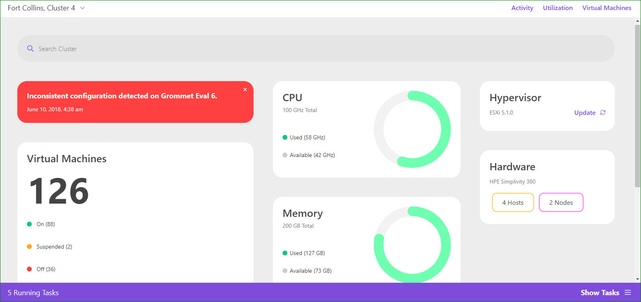
As a Service
Notes:
Sample application built using Grommet. It is backed up by backend DB.
Raise your hands if you develop any application that use database?
How do you get access to the DB that you're using for your app? Submit help desk ticket??
In reality, most of you probably don't operate all the services your app depend on.
How do you get credentials of your DB?
Email? Or write it on paper and hand over?
Let’s see how Grommet Service Broker can expose this Grommet application as a service and how cloud provider consume and provision this by using OSB API specifications.

Slide 22
Open Service Broker API
Notes:
The Open Service Broker API defines an HTTP(S) interface between Platforms and Service Brokers.
Enter the Open Service Broker API. It’s a specification of an API to allow for the automated deployment, management, and use of services, which can be pretty much anything. App developers can instantiate services and attach them to apps without having to care how those services are ultimately created or managed. The OSB API is based on the service architecture originally developed for Cloud Foundry, a platform-as-a-service.
The client side of the API is implemented by the cloud platform looking to make use of services. In our case, this is the Kubernetes Service-Catalog. The server is side is implemented by the service provider, and consists of many endpoints the client hits to provision and manipulate services. The three most important endpoints to remember are catalog, service instances, and service bindings, which I’ll go over in more detail later on.

Slide 23
Why Open Service Broker API
Service brokers are the missing link between the consumer and the provider.
Service
Consumer
Service
Catalog
Service
Broker
Service
Provider
Notes:
Ok, so first let see about the problem the Open Service Broker API is attempting to solve. In some cases Application running on premise or cloud doesn't depend on other resources but in reality it still require access to the network of resources they depend on - databases, caches, email systems, subscriptions to subsystem APIs, among others. And where as before these could be statically configured, now they must be managed dynamically as app instances are spun up and deleted.
So, how do we solve this problem? Keeping in mind that we want to take as much of the cognitive load off the app developers as possible. We don’t want app devs to be responsible for starting or configuring these services. We want it to be as plug and play as possible. On top of that, we don’t want cloud providers to be saddled with that responsibility either.
Service Brokers are written following the OSB API Specifications
What is a Service Broker?
When building applications, teams need a streamlined way to select and consume services from a provider, whether it’s an on premise database from within their organization or a messaging service from a public cloud like Amazon Web Services. Service catalogs provide a place for teams to find these services, but don’t provide all the functionality needed to connect the consumer and the provider.
Service brokers are the missing link between the consumer and the provider. The broker holds information about the services provided, and carries out the details of ordering, provisioning, and connecting these services to the application being built by the consumer, and automates steps that used to be performed by IT operations with multiple infrastructure management tools.

Slide 24
Open Service Broker (OSB)
Broker: A broker offers set of capabilities called services
Ex: Grommet app Broker, MongoDB Broker
Catalog: Collection of services is called catalog.
A marketplace/catalog contains services from one or more brokers
Service - a capability managed by the service broker
Ex: Grommet Application as a Service
Service Instance - an instantiation of a particular service's capability
Ex: Grommet Dashboard application VM
Binding - Relationship between a service instance and an application
Ex: creds created to access 'Grommmet Dashboard app'
Notes:
First though, I’d like to explicitly define some of the terms I’ve been using. These are the abstract concepts that comprise the service broker architecture.
First off is the broker itself. This is generally a server written by the service provider that implements the server side of the OSB architecture, a specifications of various HTTP endpoints to create and manipulate services. What it actually does to create those services is up to the broker author - it could be provisioning databases in a pre-provisioned cluster, it could be deploying VMS on some IaaS, it could be prompting real people to wire up machines somewhere. For an example, think of a broker set up to offer MySQL database or a simply a VM. The Broker is the server that I connect with my cloud platform.
The rest of these are various categories and sub-categories for encapsulating information about services. A service Class is a single category of service offered by a Broker. My Grommet Broker only offers one class of services, Grommet VM, but brokers can offer multiple.
A Plan is a specific type of service offered. Under my Class of Grommet VM , I might offer multiple sizes of VM, or that are provisioned with different software versions. For our example, lets say our Broker offers a Plan for small VM with specific Grommet, and Node version.
An Instance as provisioned instantiation of a Plan. When I go and ask my Broker for to create a small VM, this is what gets provisioned, by doing whatever the Broker is configured to do - I don’t know and don’t care how it gets created, as long as it does. In our example, this would be a small EC2 VM with Grommet application running.
Finally, a Binding is a single set of credentials for access to a specific service Instance. In our case, it might look something like a username Admin, a password , and maybe a URL for where our EC2 instance is accessible.

Slide 25
Expose Grommet App as a service using OSB Broker
Kubernetes Service Catalog
AWS
K8 Catalogs
Catalog Registry
OSB Grommet Broker
Grommet App vms
Operator
Kubernetes
Cloud
Notes:
Shows the high level architecture of Kubernetes cluster with service catalog and OSB broker and Grommet VMs provisioned in AWS cloud.

Slide 26
Registering a Service Broker
Fetch Catalog GET /V2/catalog
CLOUD PLATFORM
SERVICE
BROKER
Return listing of services and plans
200 OK
Notes:
Ok, now that we understand what Brokers and all those other terms refer to, I’m going to briefly go over the basic workflow of adding and using a Broker to your cloud platform. The first thing that needs to happen is we need to associate a Broker with our platform somehow - this is called registering a Broker. Your cloud platform sends a GET request to the /v2/catalog endpoint on the broker, which responds with a 200 OK and a body containing all the information about the services the broker offers. It’s up to the cloud platform to store this data and make it available to users.

Slide 27
Creating a Service
CLOUD PLATFORM
SERVICE
BROKER
Provision service Instance
PUT /V2/service_instances/:service_id
Sync or Async provisioning result
201 Created or 202 Accepted
Notes:
Now, if I want to create a service, I send a PUT request to /v2/service_instances/:service_id, where service ID is the a unique ID for the service being created. It’s up to the platform to create and track these. Once the service has been created, the broker returns a 201 to the platform.

Slide 28
Binding a Service
CLOUD PLATFORM
SERVICE
BROKER
Create Binding
PUT /V2/service_instances/:instance_id/
service_bindings/:binding_id
Return access details (service dependent)
201 Created or 202 Accepted
Notes:
Once we have created an Instance, we need to create a binding to be able to access that Instance. This is done in a similar way to the last request, with a PUT request to /v2/service_instances/:instance_id/service_bindings/:binding_id, where binding ID is some globally unique ID that the platform has created. We again receive a 201 response.
Fetching a Service Binding: GET /v2/service_instances/:instance_id/service_bindings/:binding_id
Types of Binding:
1. Credentials
2. Log Drain
3. Route Services
4. Volume Services

Slide 29
UnBinding a Service
CLOUD PLATFORM
SERVICE
BROKER
Delete Binding
DELETE /v2/service_instances/
:instance_id/service_bindings/:binding_id
Return confirmation
200 OK or 202 Accepted
Notes:
Once we are done using the instance and thinks that we don’t need the instance any more, we need to delete binding to remove the access to that Instance. I send DELETE request to /v2/service_instances/:service_id/service_bindings/:binding_id, where binding ID is some globally unique ID that the platform has created. We again receive a 200 or 202 response and also cloud platform clears the access credentials stored locally.

Slide 30
Deprovision Instance
CLOUD PLATFORM
SERVICE
BROKER
Delete Service Instance
DELETE /v2/service_instances/:instance_id
Return confirmation
200 OK or 202 Accepted
Notes:
Now, if I want to remove the provisioned service instance, I send a DELETE request to /v2/service_instances/:service_id, where instanceID is the a unique ID for the service being created. It’s up to the platform to create and track these. Once the service has been deleted, the broker returns a 200 OK to the platform else return 202 Accepted if deletion is in progress.
Fetching a service Instance: GET /v2/service_instances/:instance_id
Updating a service instance: PATCH /v2/service_instances/:instance_id

Slide 31
Questions?
Notes:
Ok, now that I’ve covered the basics of what the Open Service Broker API and architecture are like, does anyone have any questions before I dive into the Kubernetes implementation of this?

Slide 32
K8 Service Catalog
Service-Catalog
API Server
Application
(Grommet Dashboard)
Service Brokers
kubectl
create
Service Brokers
Service Brokers
Secret
(creds from Service Broker)
Service-Catalog
Controller
Bind-Service
ClusterServiceBrokers
ClusterServiceClasses
ClusterServicePlans
ServiceInstances
ServiceBindings
Open Service Broker API
32
Notes:
Service Catalog is an extension API that enables applications running in Kubernetes clusters to easily use external managed software offerings, such as a datastore service offered by a cloud provider.
It provides a way to list, provision, and bind with external Managed Services from Service Brokers without needing detailed knowledge about how those services are created or managed
Ok, so with that in mind, here is an overview of what Service-Catalog itself looks like. It’s a custom kube API Server and controller that maintains state for 5 new Resource types that correspond to their equivalents from the OSB API. The Controller implements the client side of the OSB API itself, allowing it to query service brokers for their catalogs, and to manipulate them to provision and maintain services. It also makes use of a native Kubernetes Resource, Secrets, to inject credentials for service bindings into running Pods, but more on that in a moment.
Everything I mentioned about the OSB architecture earlier is contained in this interface between the Controller and the service brokers. App developers don’t have to be aware of it, and continue to use Kubernetes the same way as before, issuing CRUD commands through the API service as normal

Slide 33
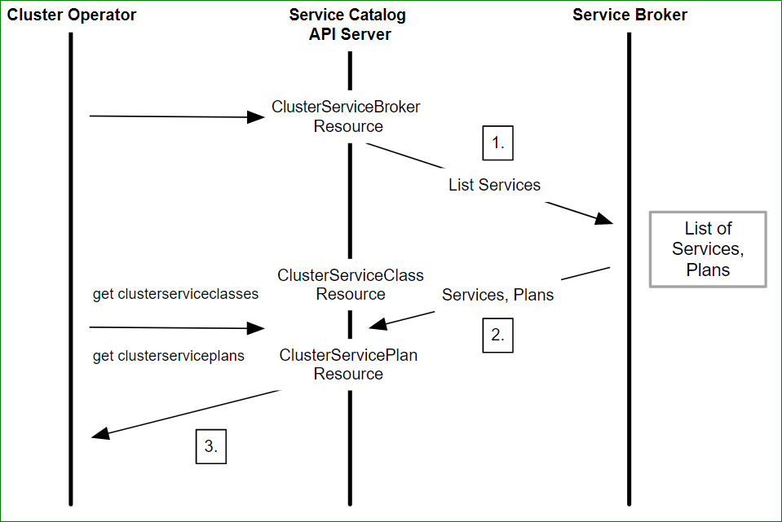
Services and Service Plans
Notes:
Here, cluster operator creates a ClusterServiceBroker resource within the servicecatalog.k8.io group. This resource contains the URL and connection details necessary to access a service broker endpoint. Service catalog control manager triggers a call to external service broker for a list of available services. The Service broker returns a list of available managed services and a list of Service Plans which are cached locally as CLusterServiceClass and CLusterServicePlan resources respectively. A cluster operator can then get the list of available managed services and Plans using kubectl getclusterservicecalassess or clusterserviceplans commands.

Slide 34
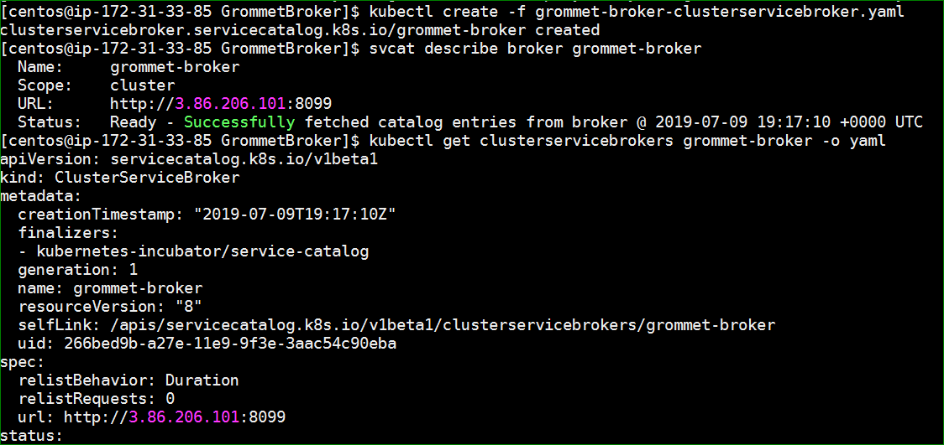
Register Grommet Broker
Notes:
kubectl create –f grommet-broker-clusterservicebroker.yaml
svcat describe broker grommet-broker

Slide 35
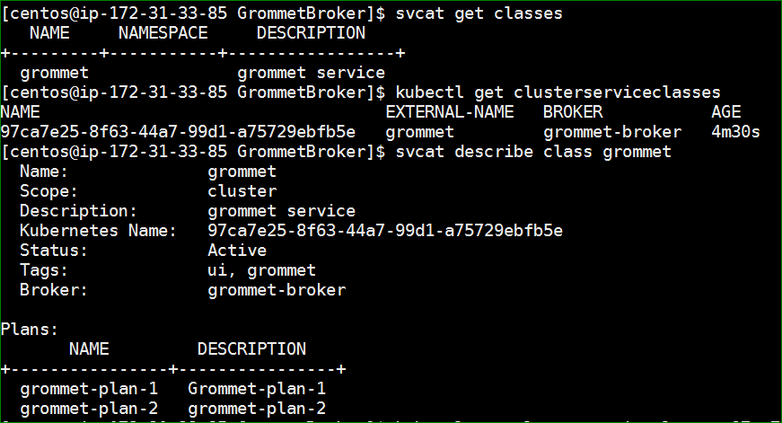
Grommet Services and Plans
Notes:
svcat get classes

Slide 36
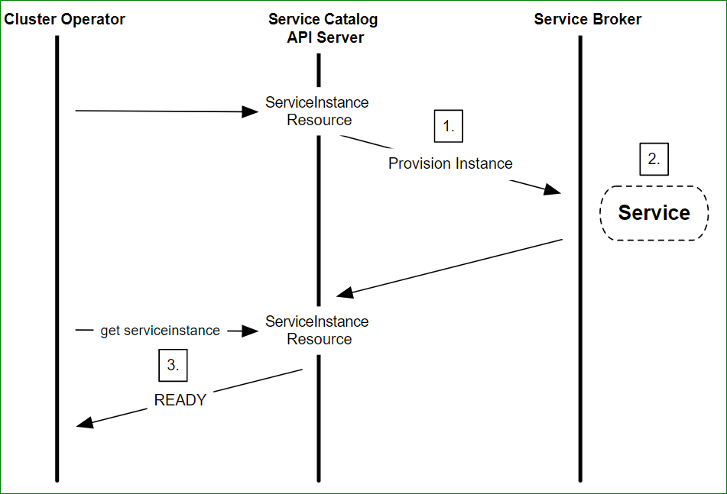
Provisioning a new Instance
Notes:
Here, cluster operator can instantiate the provisioning of a new instance by creating a ServiceInstance resource within the servicecatalog.k8.io group. When the ServiceInstance resource is created, Service catalog control manager initiates a call to external service broker to provision an instance of the service. The Service broker creates a new instance of the managed service and returns an HTTP response. A cluster operator can then check the status of the instance to see if it is ready.

Slide 37
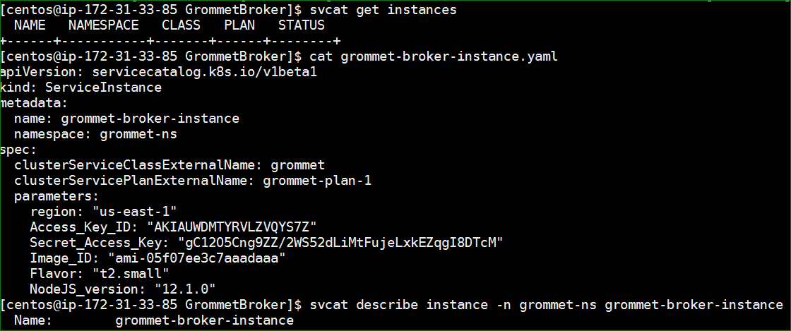
Provision Grommet Instance
Notes:
Kubectl create –f grommet-broker-instance.yaml
Svcat get instances

Slide 38
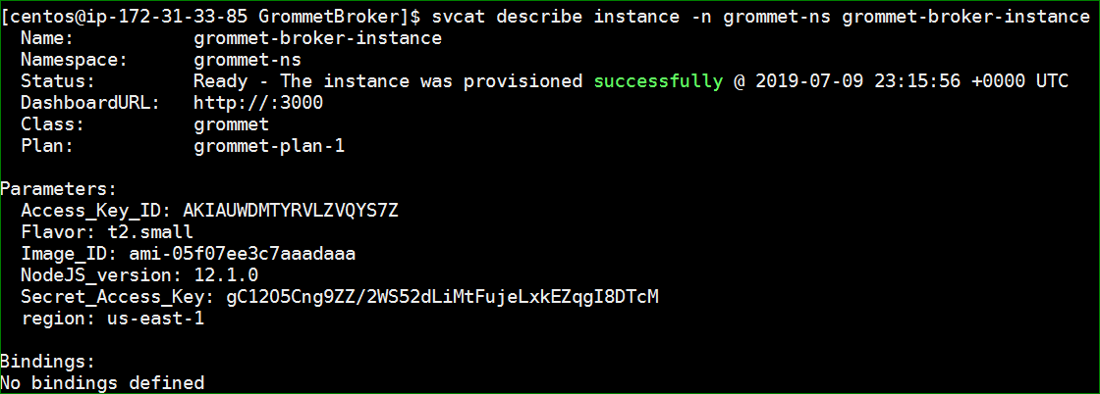
Provision Grommet Instance

Slide 39
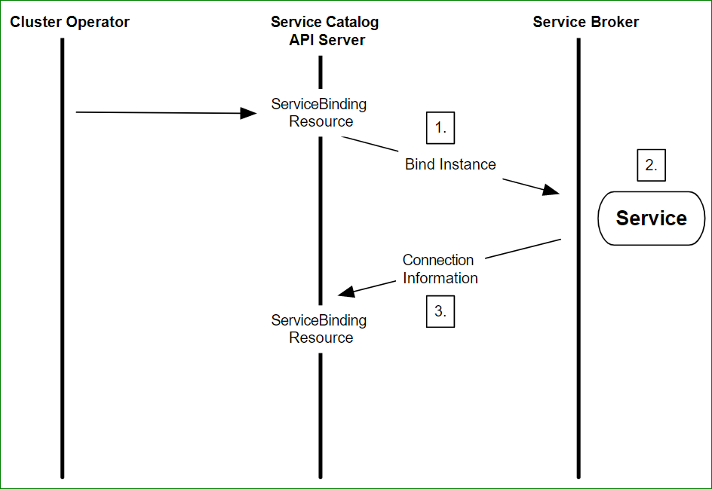
Binding to a Managed Service
Notes:
After a new instance has been provisioned, a cluster operator must bind to the managed service to get the connection credentials and service account details necessary for the application to use the service. This is done by creating a ServiceBinding resource.
After the ServiceBinding is created, Service Catalog makes a call to the external service broker requesting the information necessary to bind with the service instance.
The service broker enables the application permissions/roles for the appropriate service account.
The service broker returns the information necessary to connect and access the managed service instance. This is provider and service-specific so the information returned may differ between Service Providers and their managed services.

Slide 40
Binding Grommet Instance

Slide 41
Mapping the Connection Creds
Service-Catalog
API Server
Application
(Grommet Dashboard)
Service Broker
kubectl
create
Managed Service Instance
Secret
(creds from Service Broker)
Service-Catalog
Controller
Bind-Service
ClusterServiceBrokers
ClusterServiceClasses
ClusterServicePlans
ServiceInstances
ServiceBindings
Open Service Broker API
41
Notes:
After binding, the final step involves mapping the connection credentials and service-specific information into the application. These pieces of information are stored in secrets that the application in the cluster can access and use to connect directly with the managed service.
One method to perform this mapping is to use a declarative Pod configuration.
map secret values into application environment variables.
All that’s left to do now is to attach the secrets to our application.
To use a secret, a pod needs to reference the secret. A secret can be used with a pod in two ways: as files in a volume mounted on one or more of its containers, or used by kubelet when pulling images for the pod
Each secret you want to use needs to be referred to in .spec.volumes
volumes: - name: foo secret: secretName: mysecret
https://kubernetes.io/docs/concepts/configuration/secret/

Slide 42
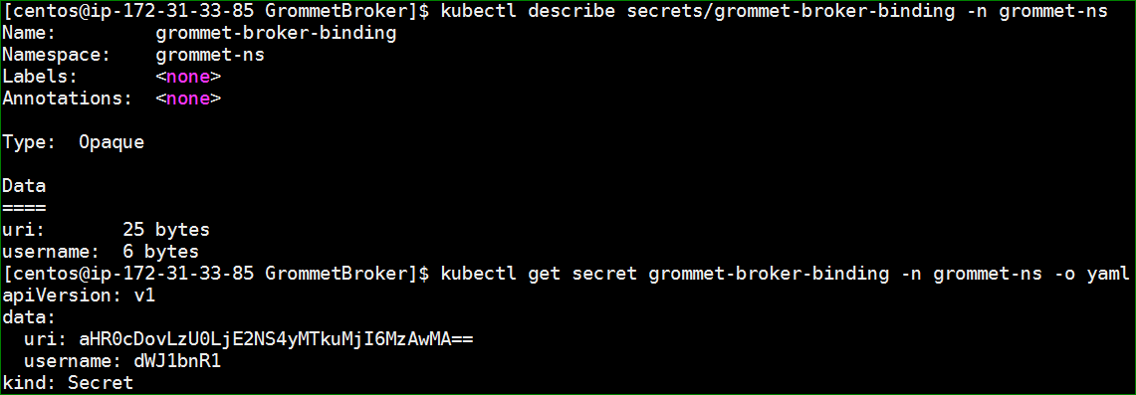
Reading Secrets

Slide 43
Access the application

Slide 44
Demo

Slide 45
References
Grommet website - https://v2.grommet.io/
Grommet components - https://v2.grommet.io/components
Grommet storybook - https://storybook.grommet.io
Grommet Github - https://github.com/grommet
Grommet Slack – slackin.grommet.io
Open Service Broker API - https://www.openservicebrokerapi.org/
Kubernetes Service Catalog - https://kubernetes.io/docs/concepts/extend-kubernetes/service-catalog/
Grommet OSB Broker - https://github.com/reddypramod85/osb-grommet-python

Slide 46
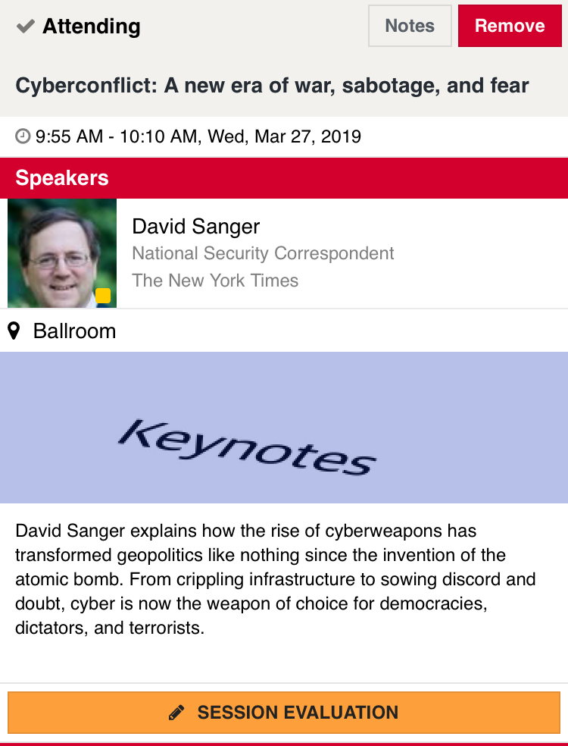
Rate today ’s session
Session page on conference website
O’Reilly Events App

Slide 47
Thanks!
@grommetux
grommet.io
Join HPE’s Developer Community
hpedev.io

